Slide 1


Airline Delay Analysis and Prediction in the US
Data science workflow using Python to analyze and predict US flight delays.
Author: Suraj Nair | Date: 3/5/25
by Suraj Nair

Slide 2




Project Overview and Objective
Objective
Data Source
Analyze and predict flight delays using real-world airline dataset.
CSV file containing comprehensive US flight records.
Link:https://www.kaggle.com/datasets/leader11113/us-flight-delay
Outcome
Generate predictive insights to improve flight scheduling and planning.

Slide 3
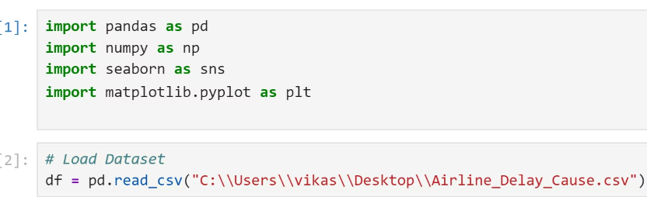
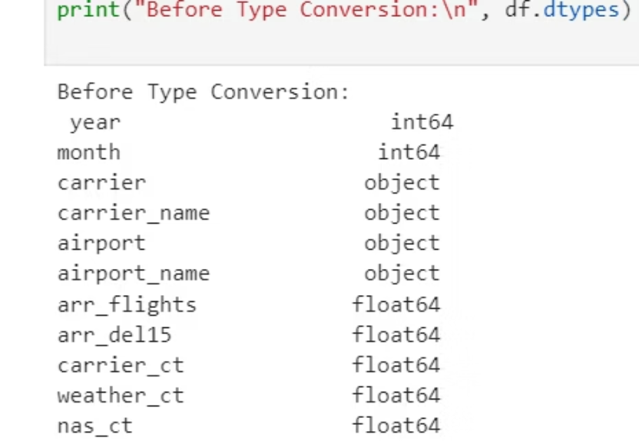
Data Loading & Initial Exploration
Loading Data
Initial Insights
Used pandas to load CSV for manipulation and analysis. Imported libraries like numpy, pandas, matplotlib, seaborn for calculations and visualization purposes.
Info(): Data types and completeness
Describe(): Statistical summaries of numerical columns
Head(): Preview of first rows for data structure

Slide 4
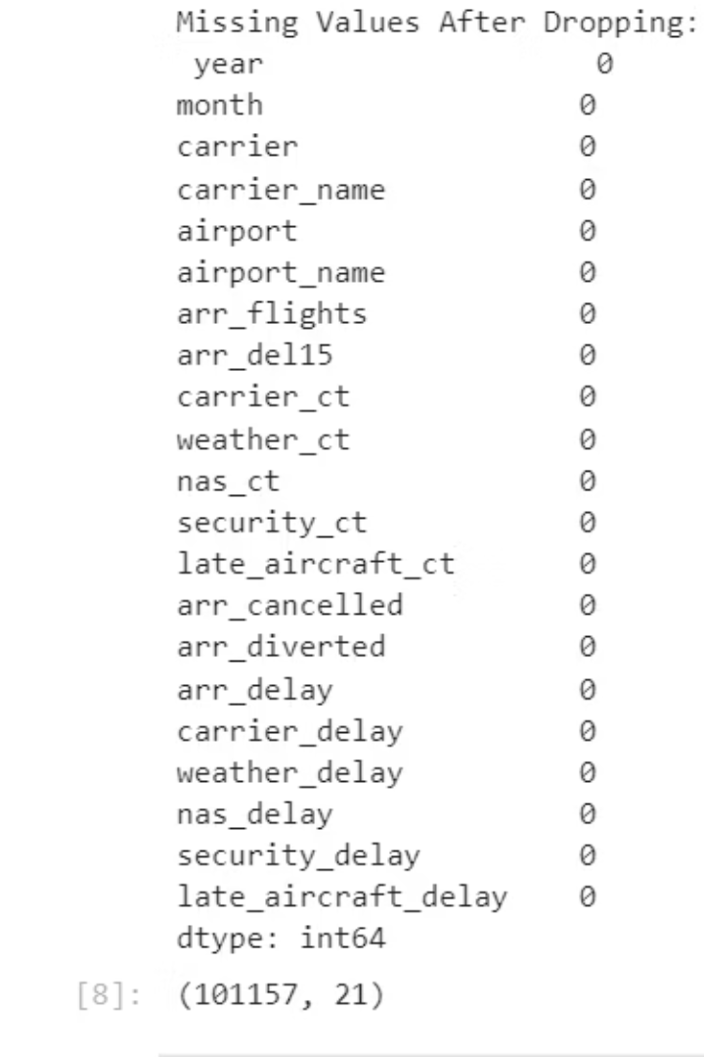
Data Cleaning and Preprocessing
Missing Values
Inconsistent Data
Handled using dropna() and fillna() to ensure dataset quality.
Removed irrelevant columns and fixed inconsistent entries and types.
Dropped rows only for 0.15% of the rows
Made delays positive by default and converted unnecessary float variables to int.
Data Consistency
Ensured uniform format for dates, times, and categorical labels.

Slide 5
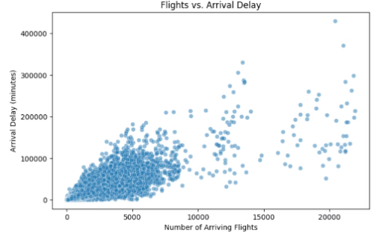
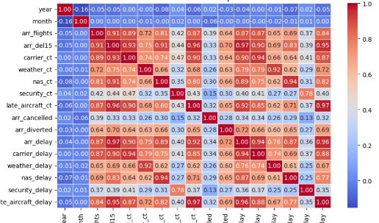
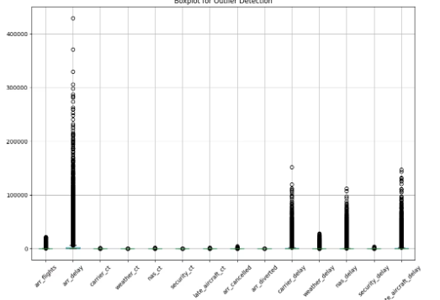
Data Visualization for Insights
Trend Analysis
Co-relation
Outlier Detection
Scatter plot to show the relation between arrival delay and number of arriving flights.
Correlation matrix shows relation of each column with another.
Heatmaps highlight unusual spikes in delay occurrences.
Inference: Delay is independent of time and year as shown in blue box and highly dependent columns are shown in red.
Inference: Non-linear, put positive co-relation.
Inference: Strong presence of outliers in arr_delay, carrier_delay and late_aircraft_delay.

Slide 6
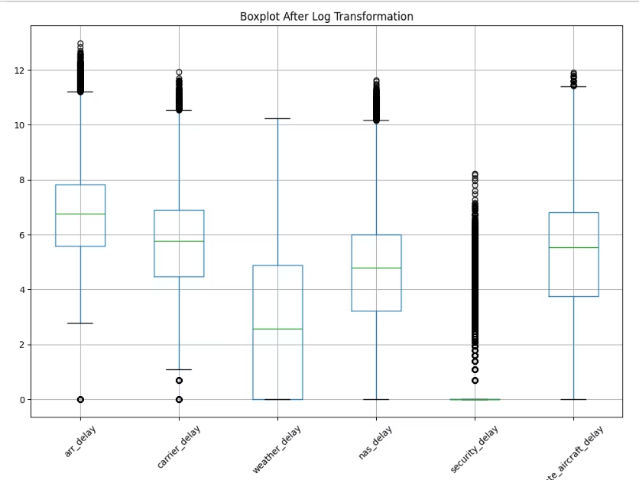
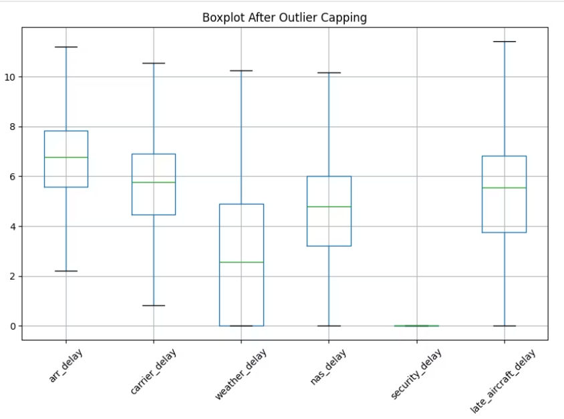
Handling Outliers
Log Transformation
Post capping using IQR
Log Transformation reduces the visible skewness, but not completely removing the outliers.
No existence of outliers. Everything is either capped or in the IQR range.

Slide 7
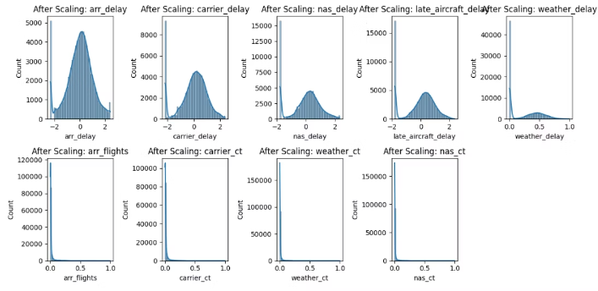
Standardization and Normalization
Objective:
Proof of successful application
Performed in order to bring features to a similar scale, ensuring that no single feature dominates due to its range. This improves model performance, especially for distance- and gradient-based algorithms.
Bell shaped curves for standardization and 0 to 1 scaling for normalization.

Slide 8



Feature Encoding
Label Encoding
One-Hot Encoding
Converted ordinal categorical variables into numeric labels.
Created binary columns for nominal categories like airlines.

Slide 9




Feature Scaling and Normalization
StandardScaler
Transforms features to zero mean and unit variance.
MinMaxScaler
Scales features to a fixed range, usually 0 to 1.
Impact
Improves model convergence and accuracy.

Slide 10
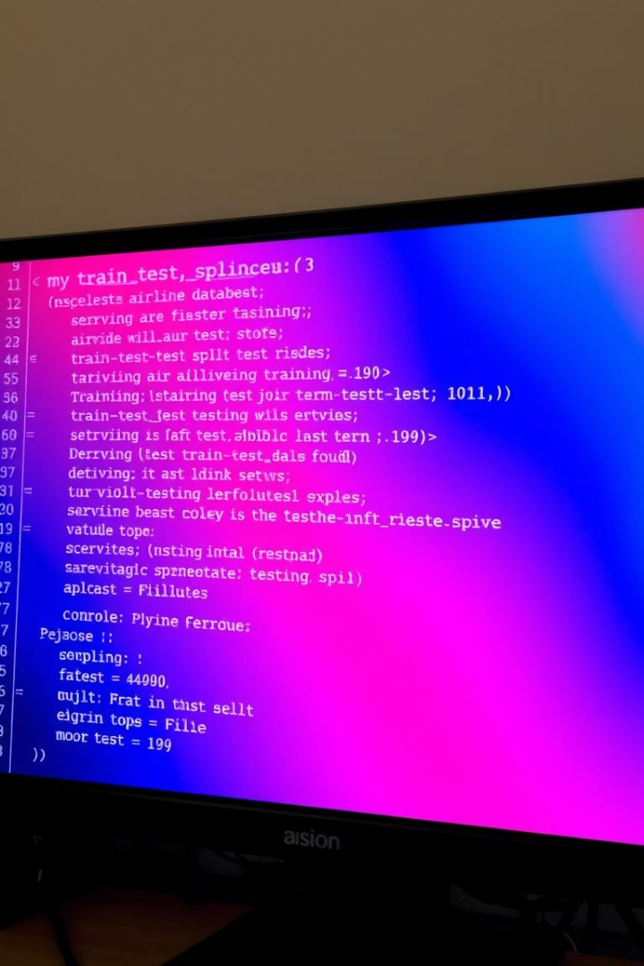
Train-Test Split
Data Separation
Divided dataset into training (80%) and testing (20%) subsets.
Random Sampling
Ensured representative and unbiased sample for evaluation.
Purpose
Test model generalization with unseen data.

Slide 11
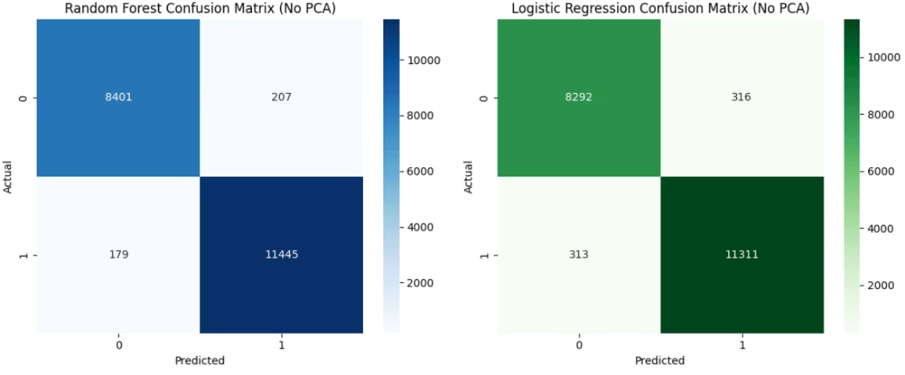
Chose 2 models-
RANDOM FOREST CLASSIFIER & LOGISTIC REGRESSION
Comparison of performance before and after PCA
Logistic Regression performed similar in both scenarios, while Random Forest gave the best results without applying PCA.
Decided to choose Random Forest
Used evaluation metrics like- confusion matrix, ROC AUC curve, and learning curve

Slide 12
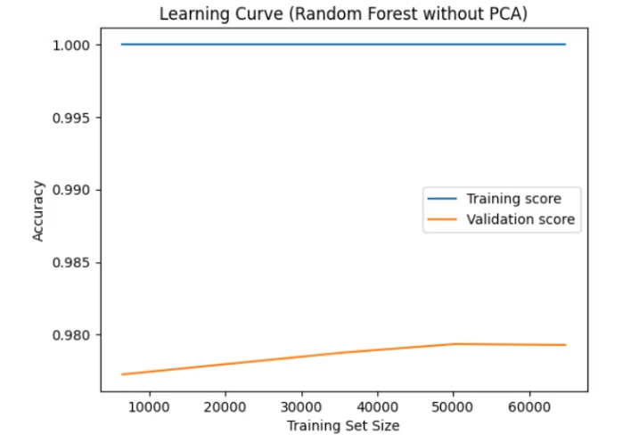
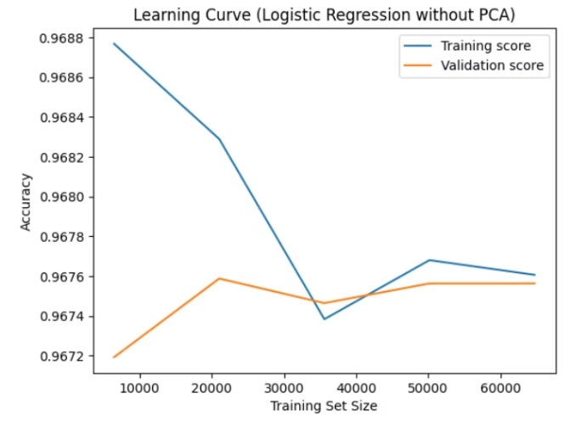
Although the gap in random forest might be looking larger, but it is important to note that the absolute values of both the scores is better than logistic regression.

Slide 13

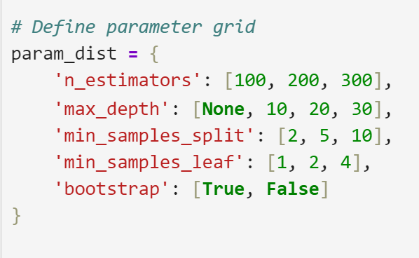
Hyperparameter Tuning
Since, in the previous graph, the gap was existing between the learning and validation scores, it suggested mild overfitting. To tackle that, and improve model performance, Hyperparameter Tuning is the best choice.

Slide 14
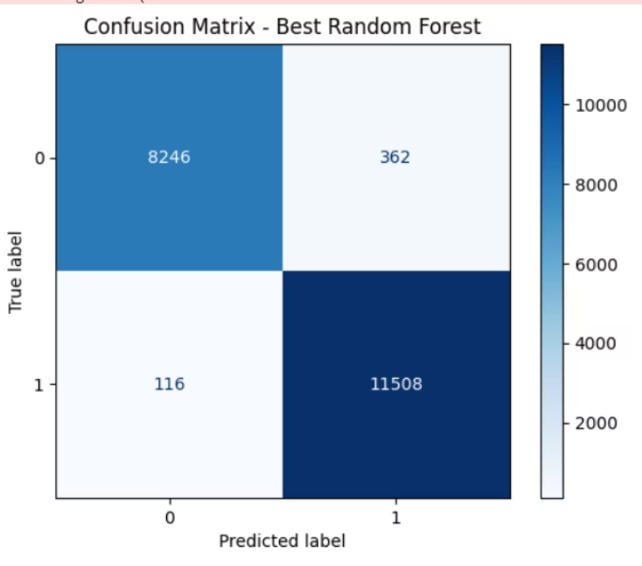
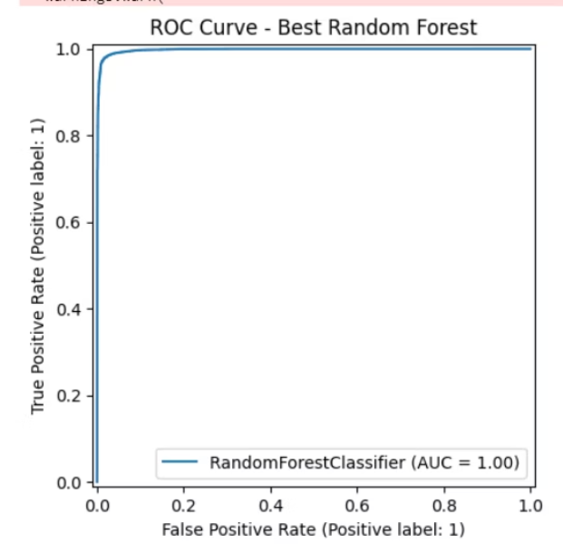
Post Tuning Results

Slide 15
CONCLUSION:
Thus, all the steps of the project have been successfully implemented from data cleaning to feature engineering and model training. This project has not just enhanced my skills in python programming and the libraries used in Machine Learning, but also generated immense interest in the same. The next step in this project I believe is deployment, which i look forward to learning in the coming period and explore other interesting stuff in Machine Learning.
NAME: SURAJ NAIR UID: 2023800066

